Slide 1
Cost Report Instructions
Created by Brandon Wilen
March 9,2011

Slide 2
Steps
Label all your parts according to the number scheme outlined by FSAE rules. https://docs.google.com/viewer?url=http://fsaeonline.com/Downloads/Appendix_C2_2011.doc
Create a spreadsheet for your assembly. Each Sub Assembly will have its own excel file but each part within that assembly will have its own Tab.
Cost out each Sub Assembly
Cost out the entire car with each Sub-Assembly included

Slide 3
Standard Part Numbering

Slide 4
Standard Part Numbering
The rules committee gave us a nice numbering scheme that we conveniently didn't use!!!!! Now we get to Re-Label all of our CAD files.
The Scheme would have worked well for document control but as I mentioned we for some reason choose not to use it.

Slide 5
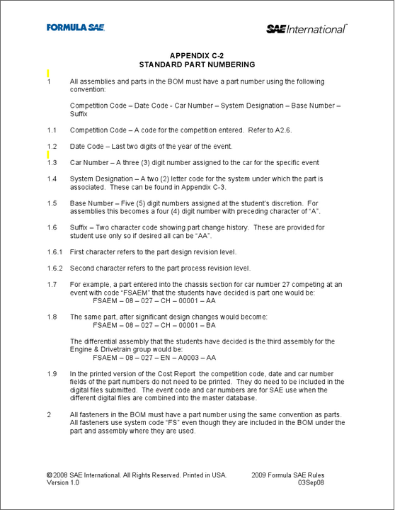
Standard Part Numbering Cont.
Viking Motorsports 2011 code will is
FSAEC-11-044-xx-xxxxx-xx
The system designations can be found here, https://docs.google.com/viewer?url=http://fsaeonline.com/Downloads/Appendix_C3_2011.doc
The 2011 numbering spreadsheet for VMS can be found here, https://spreadsheets.google.com/ccc?pli=1&hl=en&key=tIgwTSoz6m7eEfG0pnR1I7A&authkey=COmI-_EH&hl=en#gid=3

Slide 6
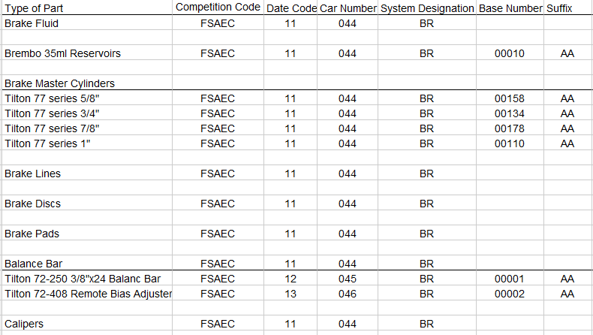
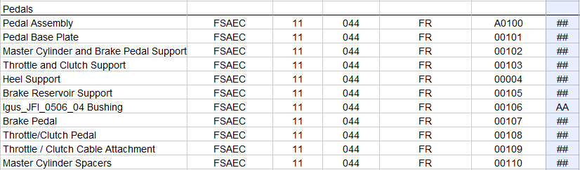
Standard Part Numbering Cont.
Example sheet for numbering

Slide 7
Cost Spreadsheet

Slide 8
Cost Factors Spreadsheets
Materials - Each Material has a different cost associated with it due to its rarity and machine ability. Purchased parts such as bearings, wheels, Master Cylinders, ECU, Dampers etc are also on this spreadsheet.
https://spreadsheets1.google.com/ccc?authkey=CPSxudcL&hl=en&key=tsEQKUUZwuNn9LJn05gavcA&hl=en&authkey=CPSxudcL#gid=0
Processes – Each type of process has a different cost associated with it. Welds are based on length, machining is based on volume of material removed, etc. Assembling a bolt with a power tool vs. a hand tool have a different cost.
https://spreadsheets0.google.com/ccc?authkey=CIb4z6AI&hl=en&key=tHcleDFQBwalLaenL4wQ4Hg&hl=en&authkey=CIb4z6AI#gid=0
Process Multiplier – Machining different materials are harder than others there for have a multiplication factor. Assembling long bolts takes longer than short bolts.
https://spreadsheets0.google.com/ccc?authkey=CL35oy8&hl=en&key=tgdP48JXNZ0jvUVJ2-vfFsw&hl=en&authkey=CL35oy8#gid=0
Tooling – Some parts need special tooling, welding fixture, casting dies, body plug, etc.
https://spreadsheets0.google.com/ccc?authkey=CODWmO8C&hl=en&key=tmQB5BknTF7km3a2H-7Ohdg&hl=en&authkey=CODWmO8C#gid=0
Fasteners – Bolts, nuts, washers, springs, clamps, retaining rings all cost differently based on size
https://spreadsheets0.google.com/ccc?authkey=CIiI8eYD&hl=en&key=tqlUuKYekTyjYDzgo5IW-eg&hl=en&authkey=CIiI8eYD#gid=0

Slide 9
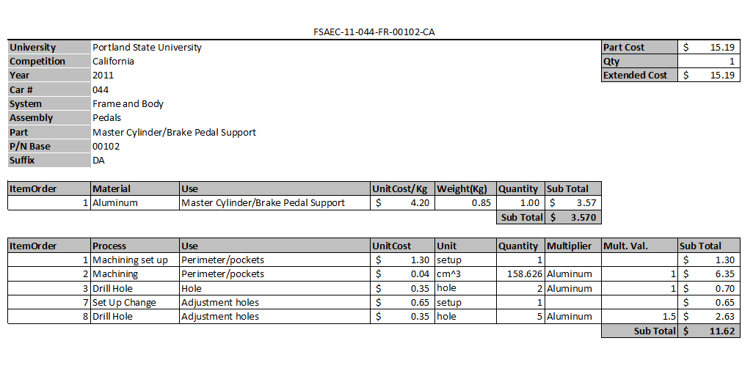
Cost out each separate machined part
Example – Master cylinder support on Pedals

Slide 10
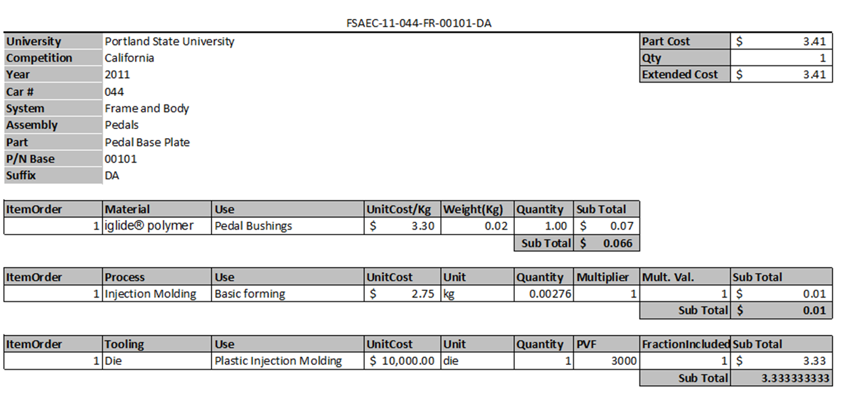
Cost out each separate machined part cont.
Example – Bushings on pedals

Slide 11
Cost out each separate assembly

